Slide 1

ASPNETCORE6RESTAPI
Sit Dolor Amet

Slide 2
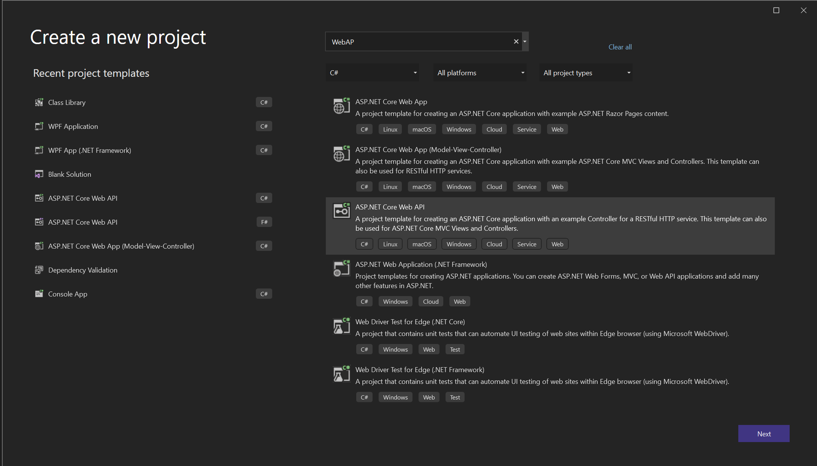
Project template

Slide 3
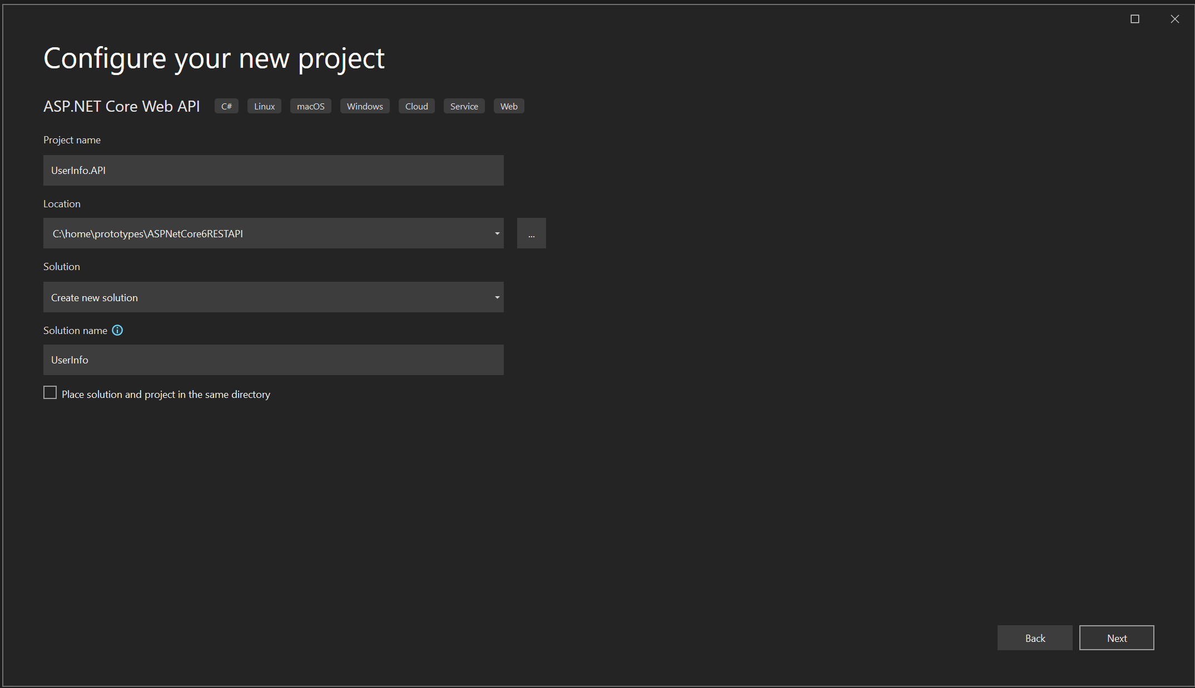
Create project

Slide 4
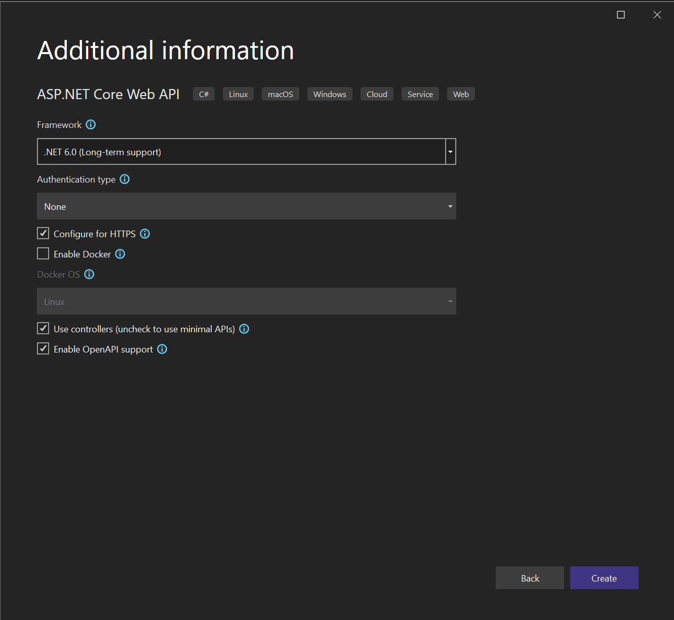
Enable open api support

Slide 5
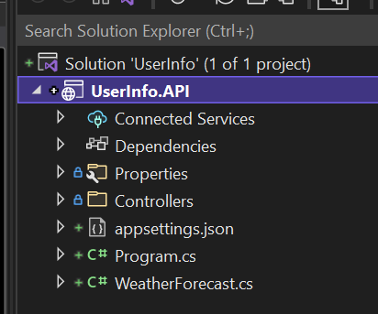
Userinfo.api

Slide 6
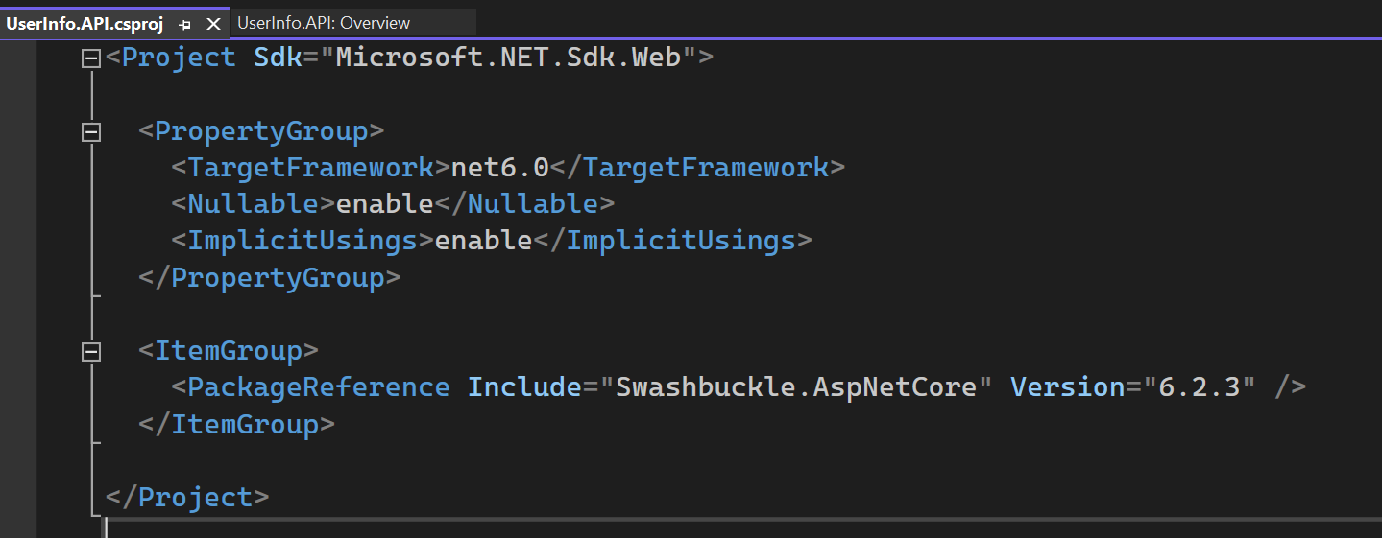
USER INFO API
Swashbuckle.AspNetCore is an implementation of OpenAPI or swagger as it used to be called for ASP.Net Core.

Slide 7
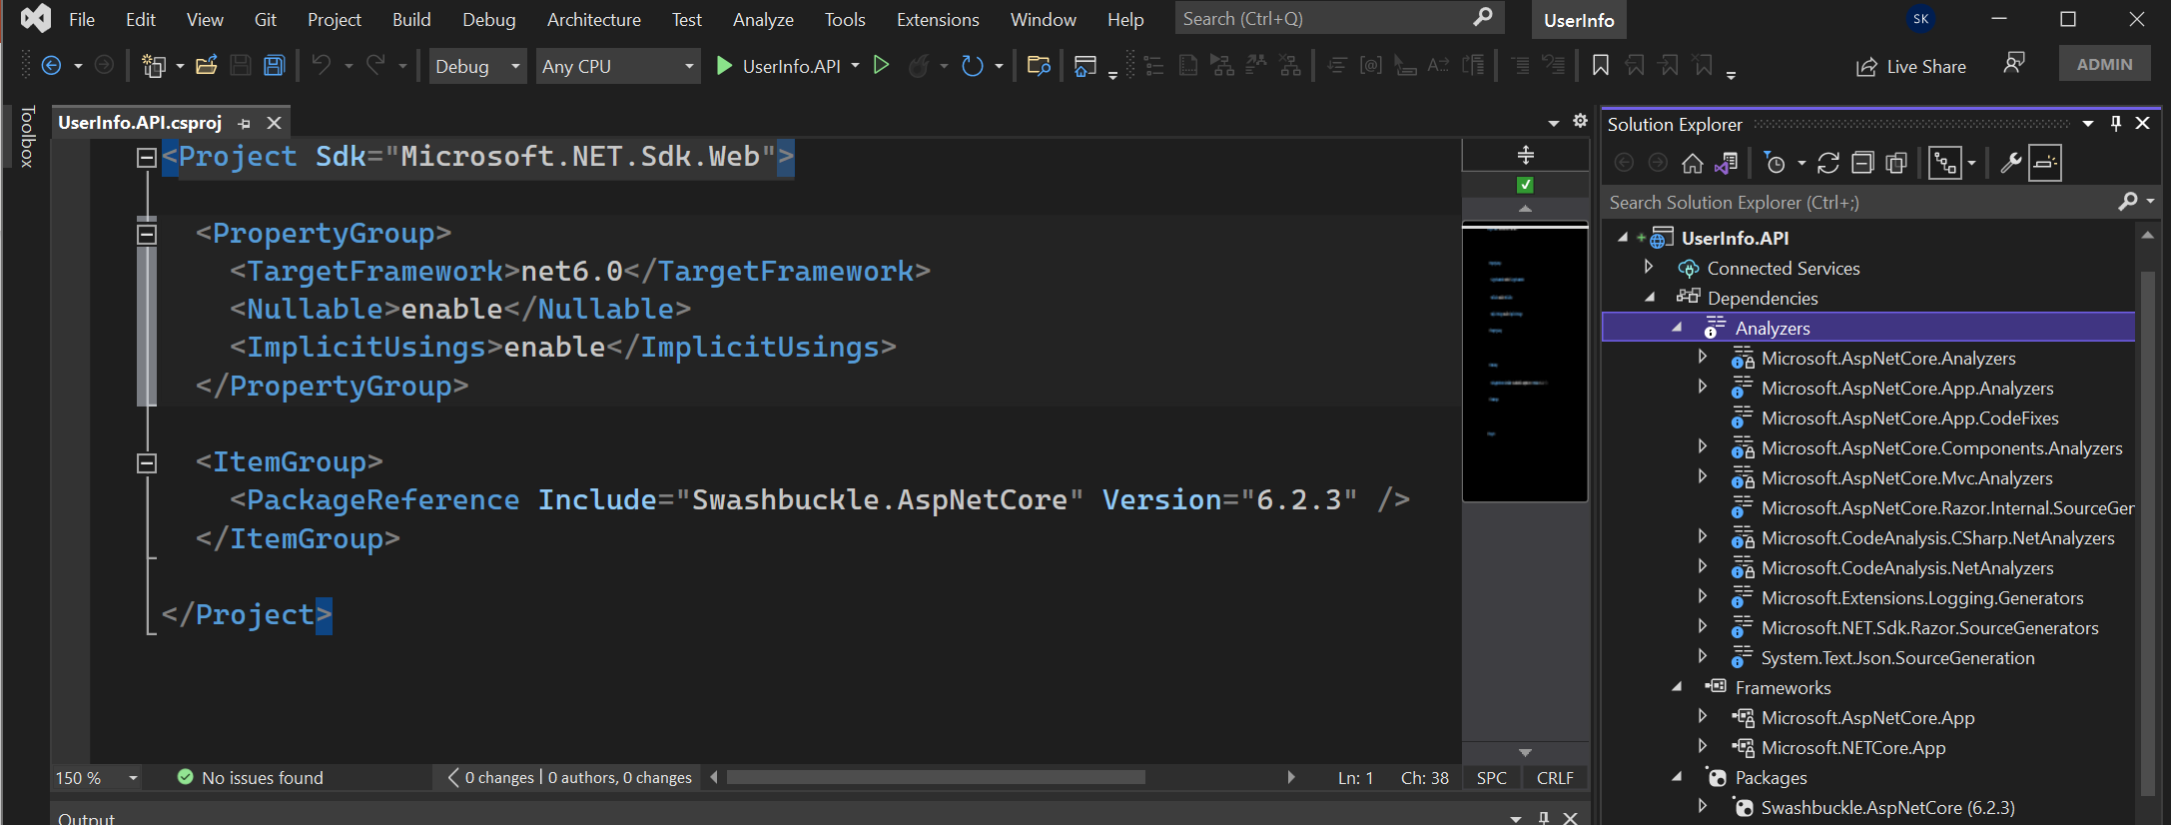
Project that target Microsoft.NET.Sdk.web implicitily target Microsoft.AspNetCore.App
It is also called as ASP.Net core shared framework.
Microsoft.NETCORE.APP are lower assemblies that make up the .NET Developer Platform.
Explicit reference packages Swashbuckle.AspNetCore for generating documentation.
Analyzers – These are packages that analyze your code while developing. It will also do code analysis.

Slide 8
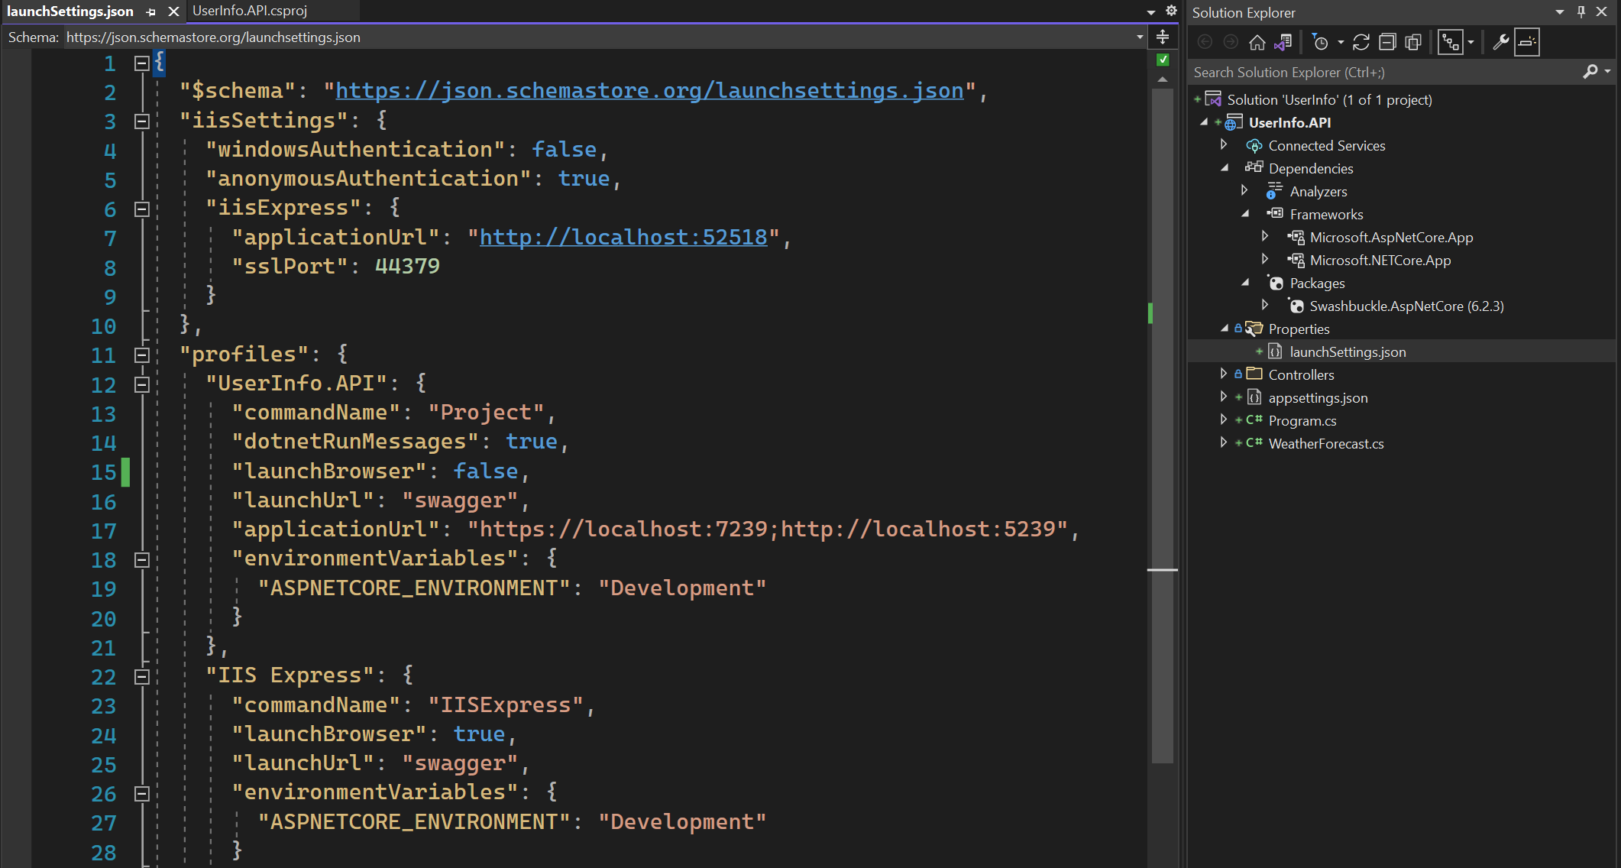
This file is used to setup the environment for local machine development. Not deployed.
The first profile contains the name “Project”. That means it use Kestrel Web Server to launch the project. It is more in line
with cross platform nature of .Net.
Change launchbrowser to false.

Slide 9
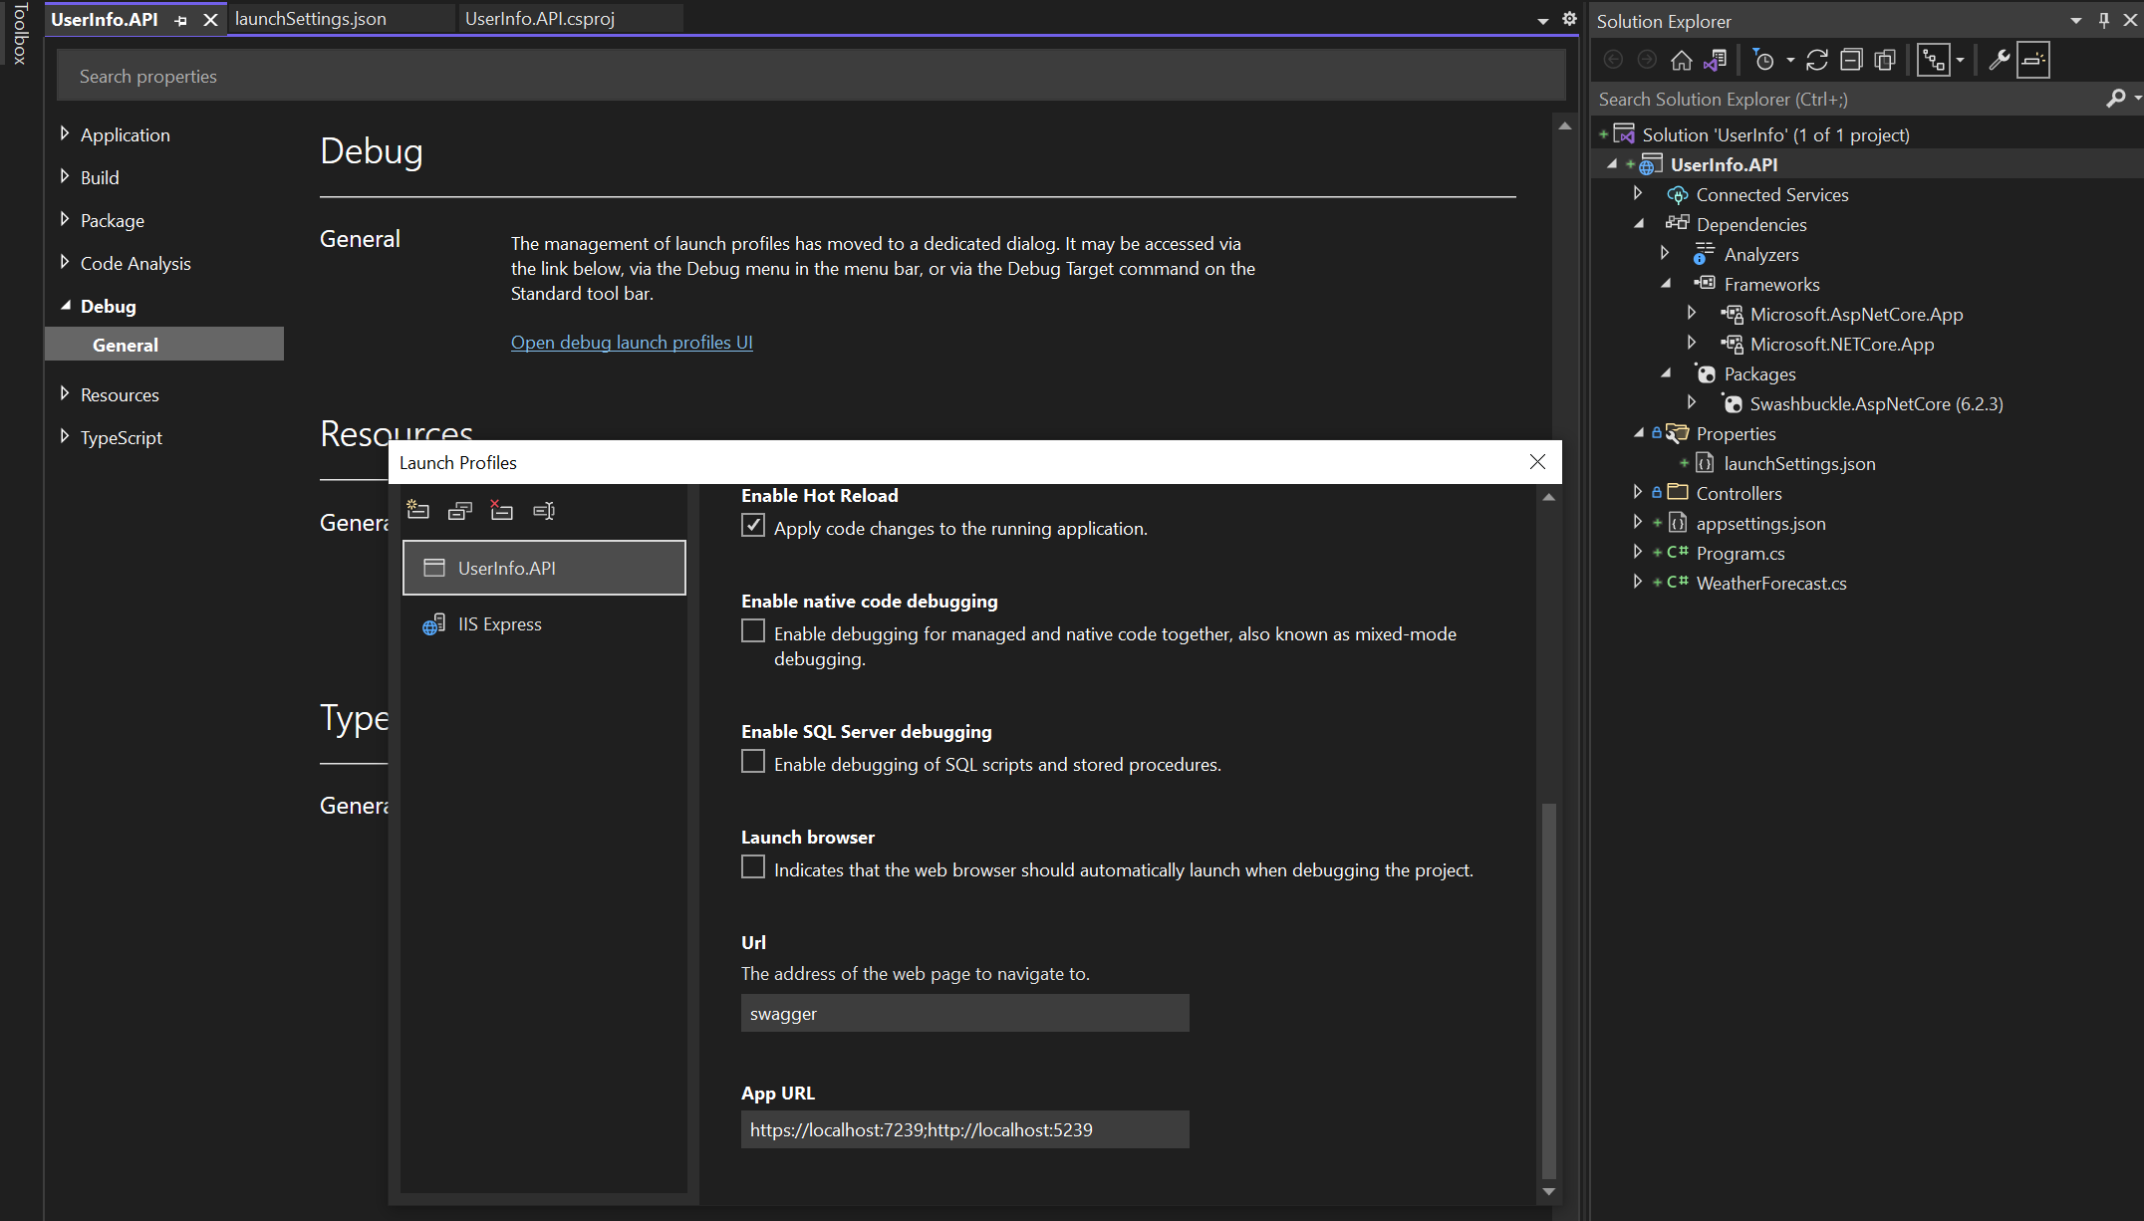
Open Launch Profiles

Slide 10
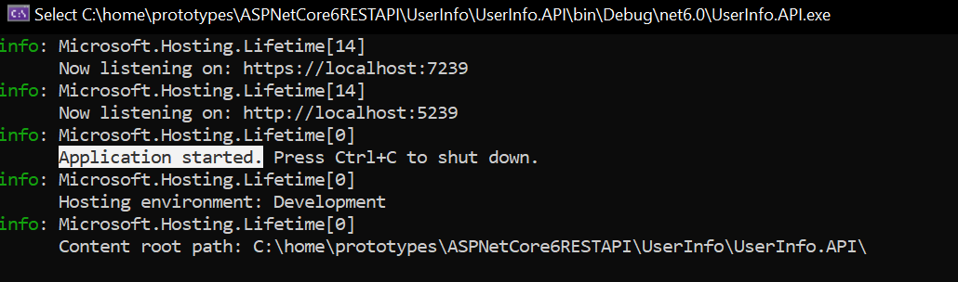
Application started

Slide 11
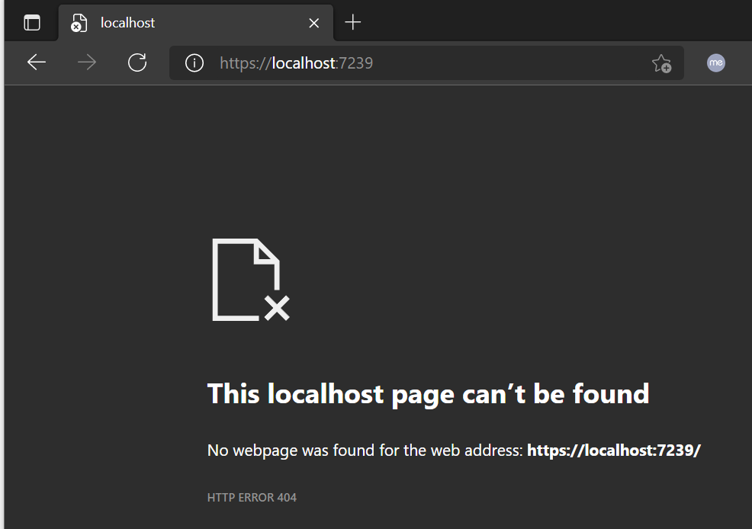
Navigate to the root

Slide 12
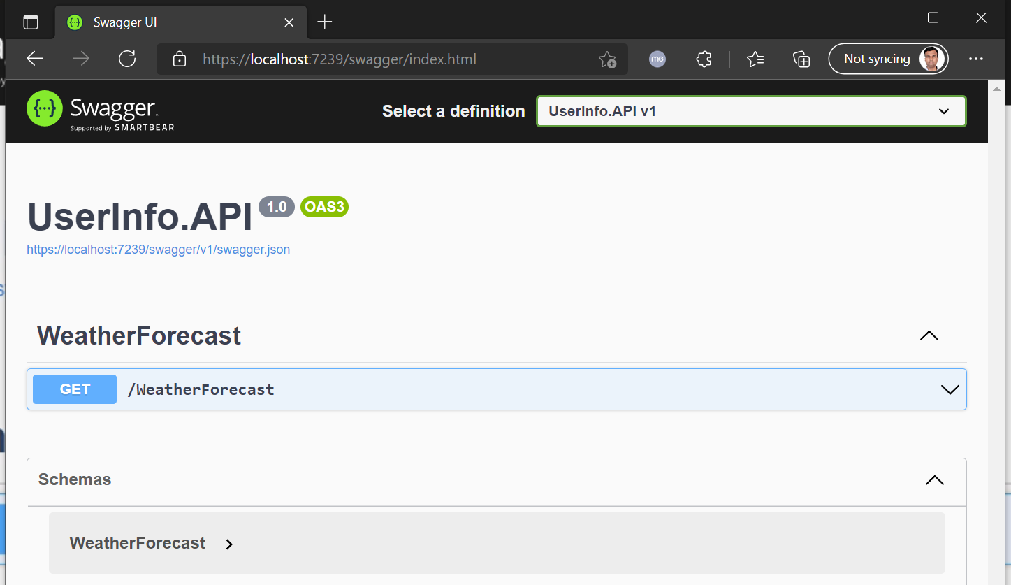
swagger

Slide 13
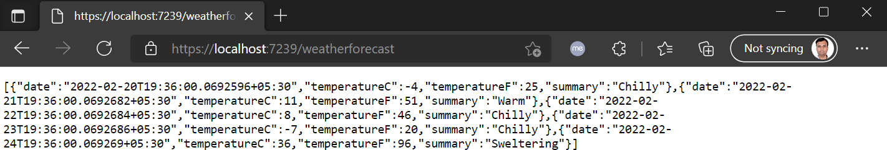
Navigate to weatherforecast

Slide 14
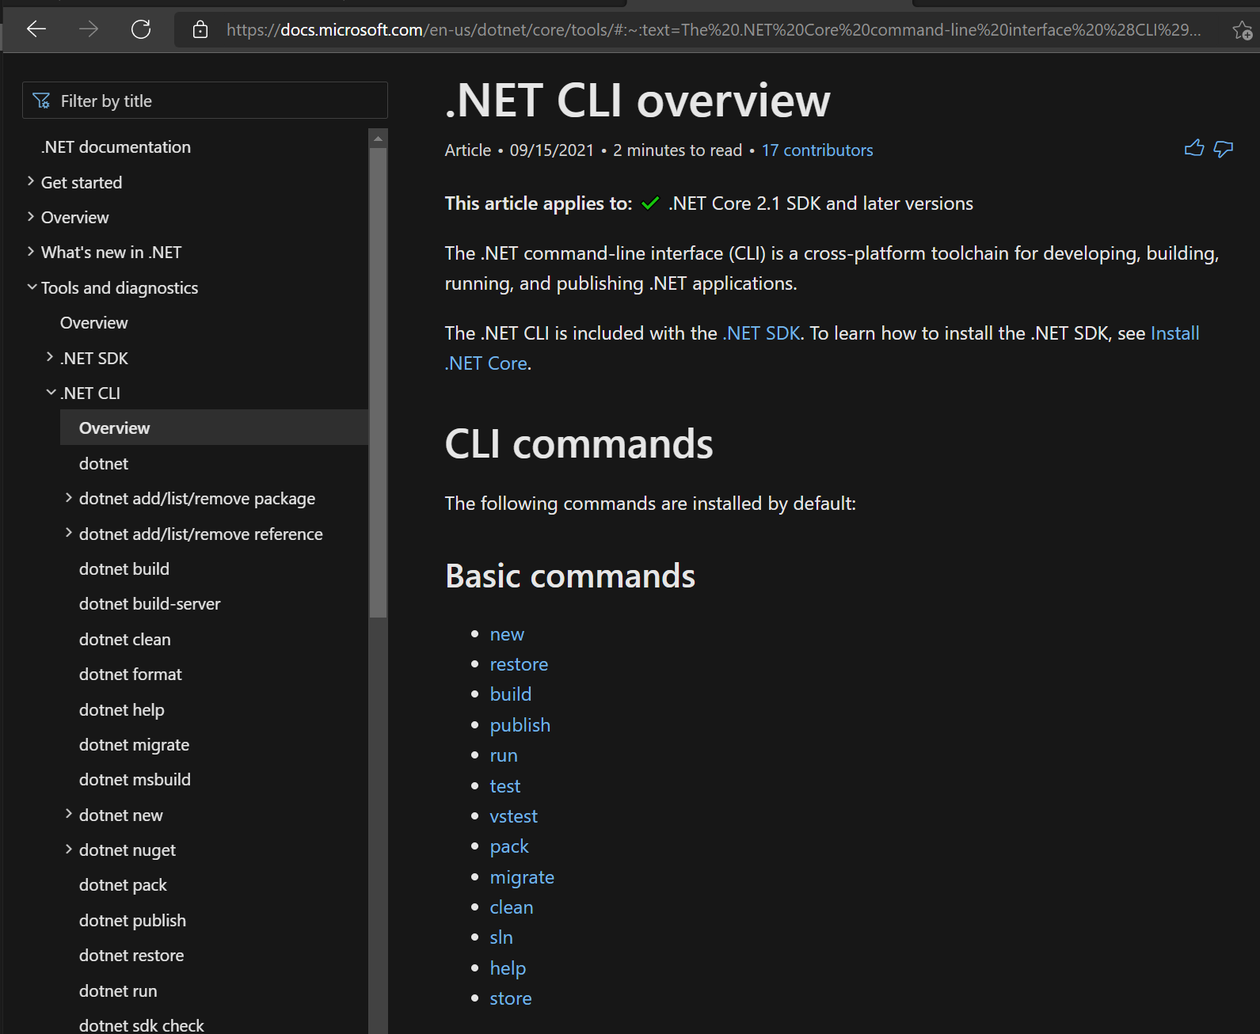
.Net CLI

Slide 15
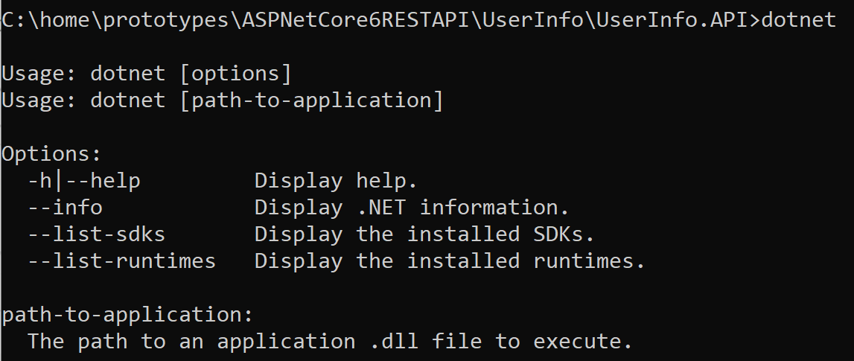
dotnet

Slide 16
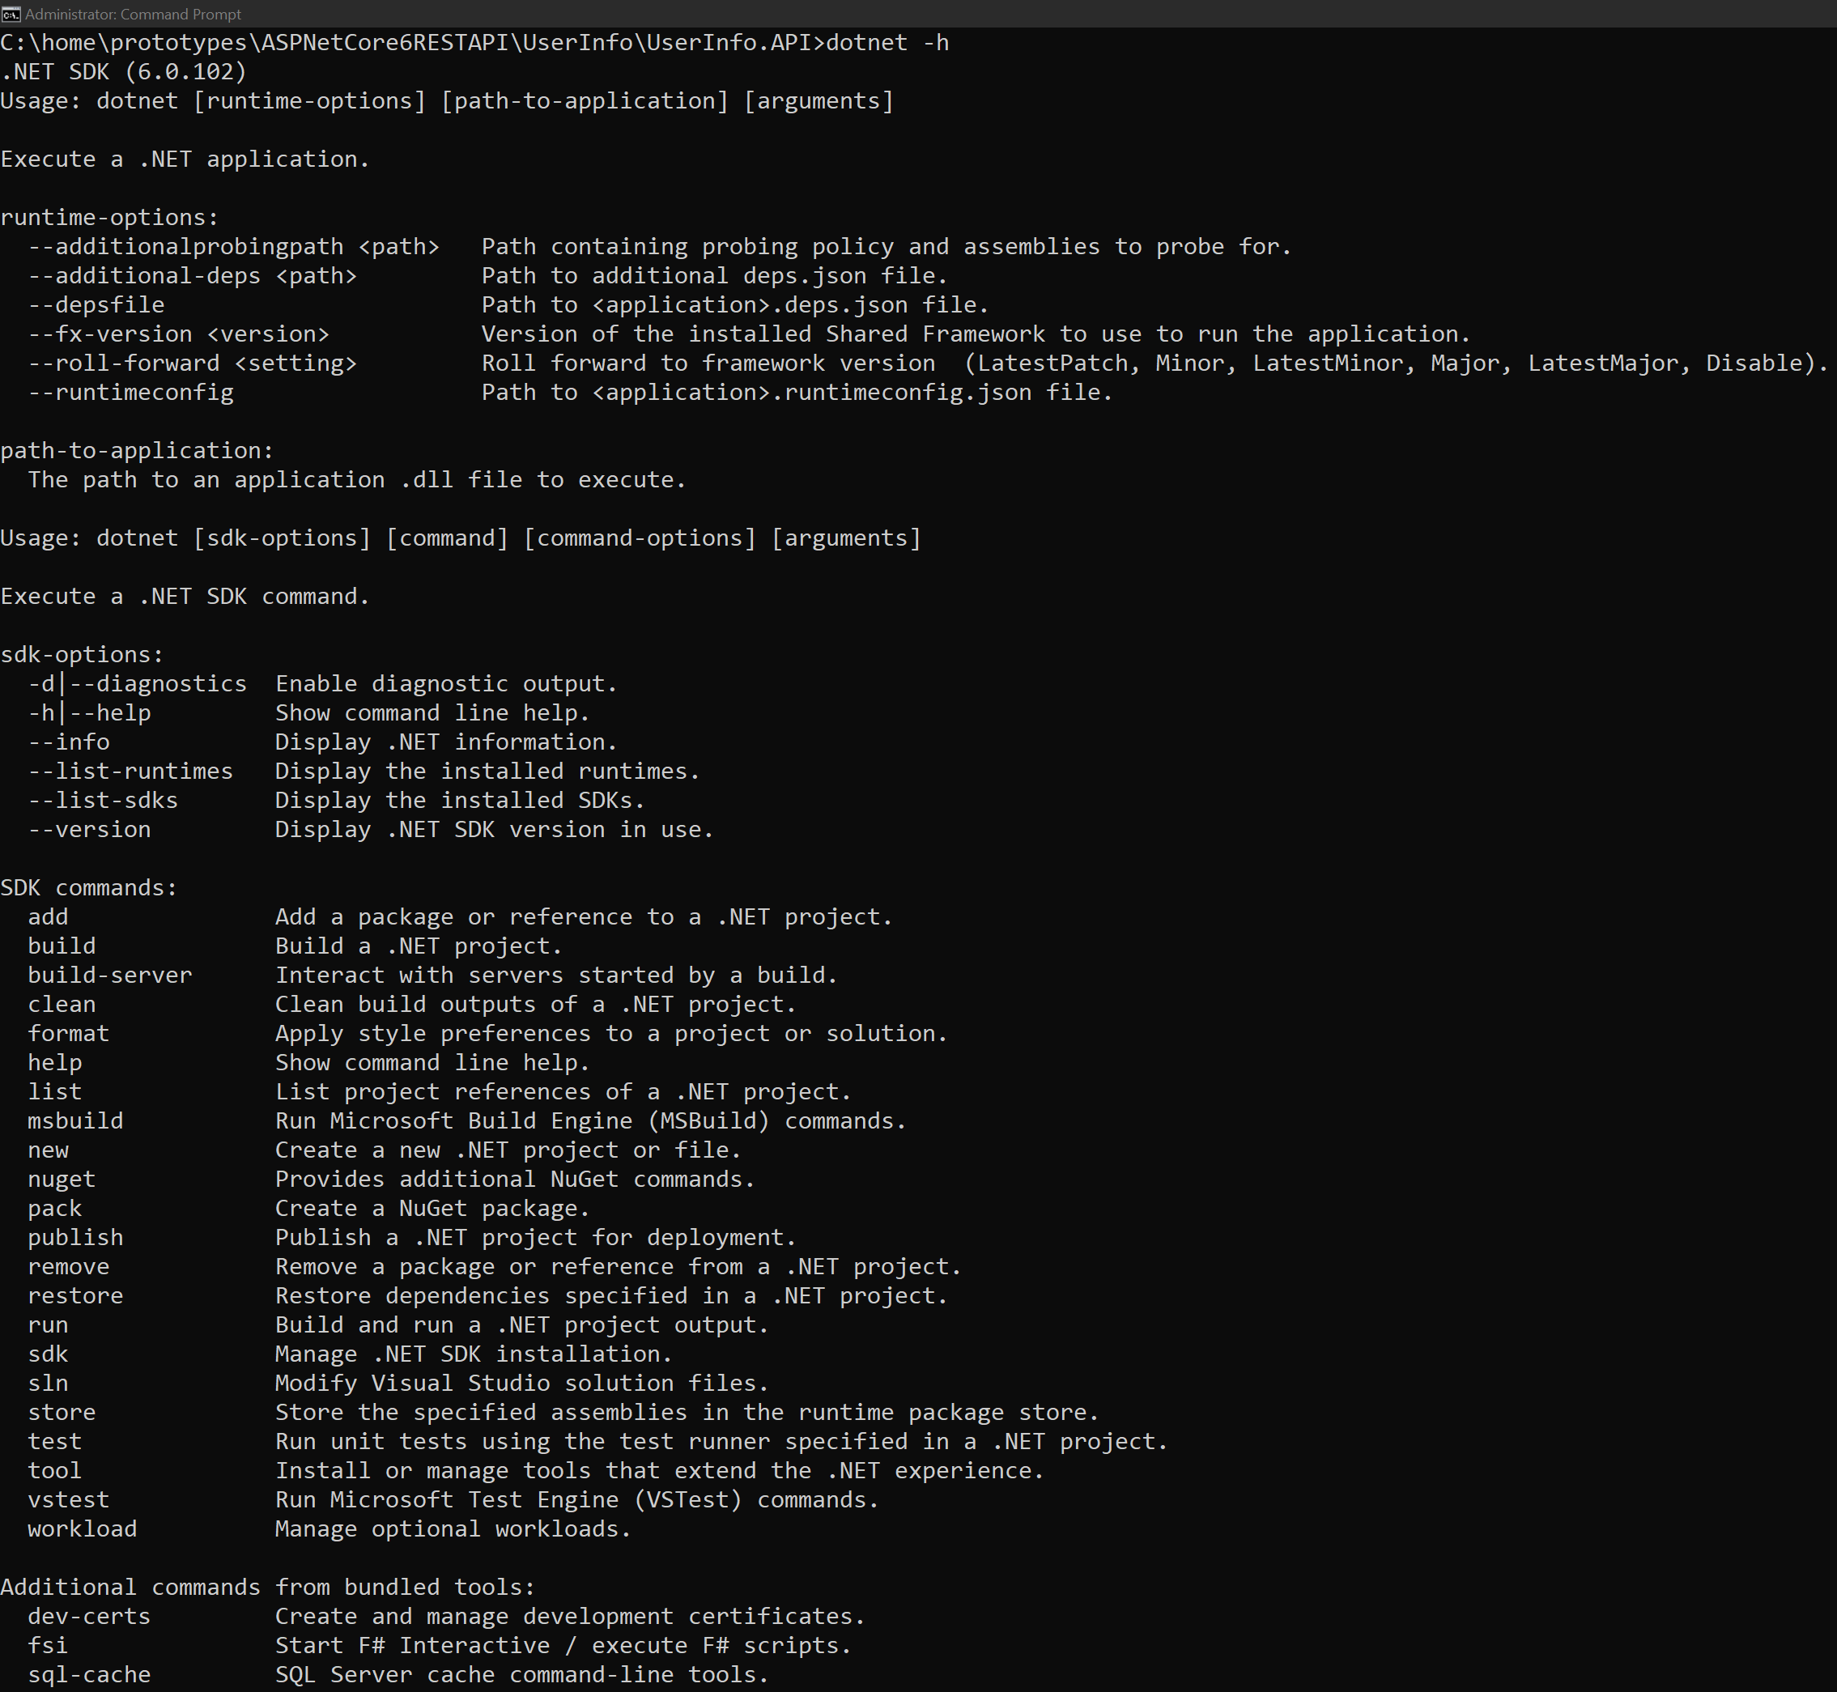
Dotnet -h

Slide 17
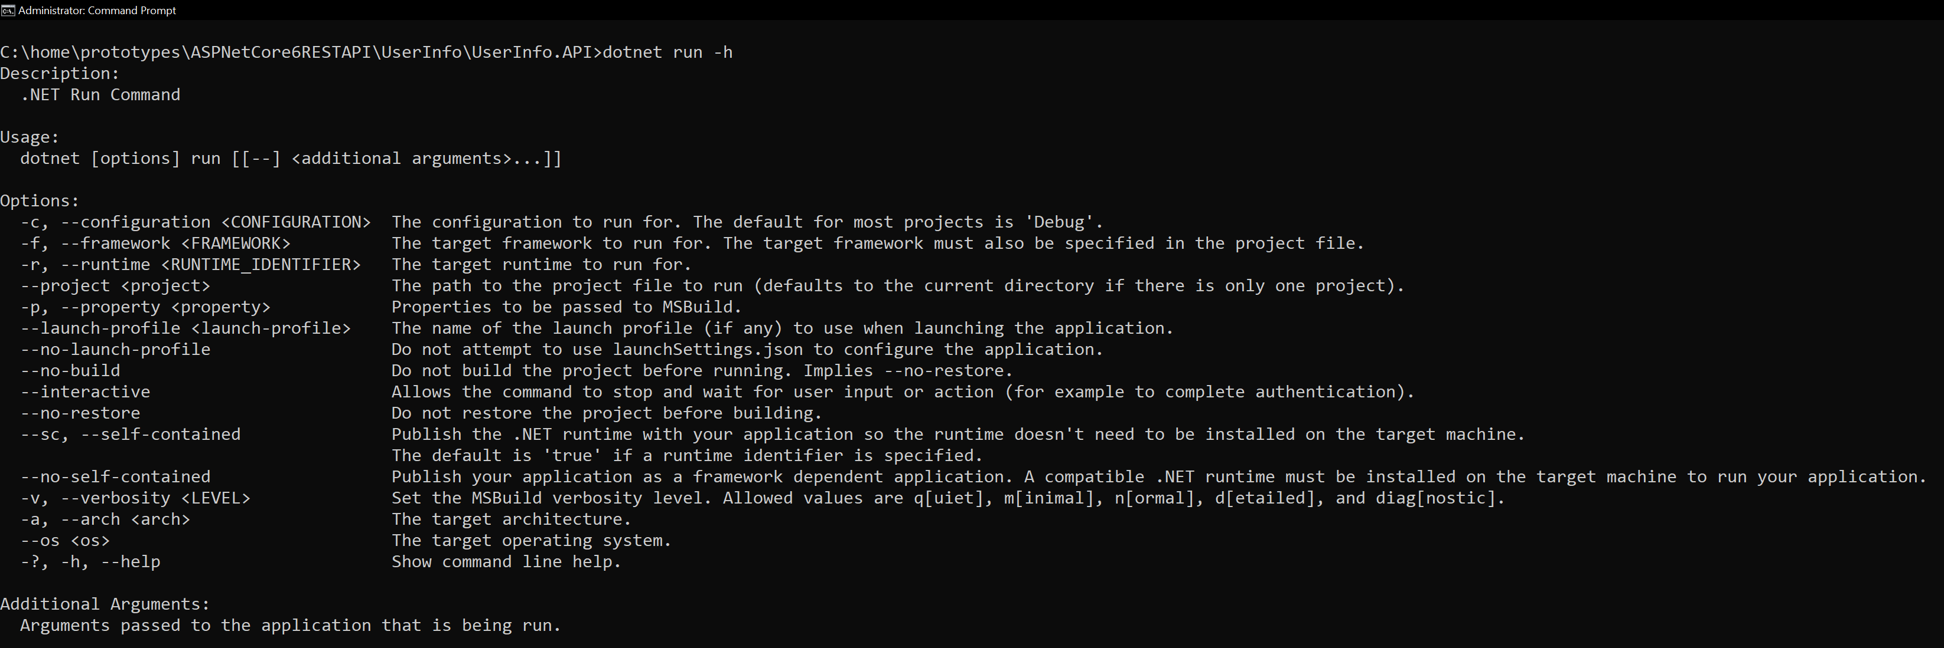
Dotnet run -h

Slide 18
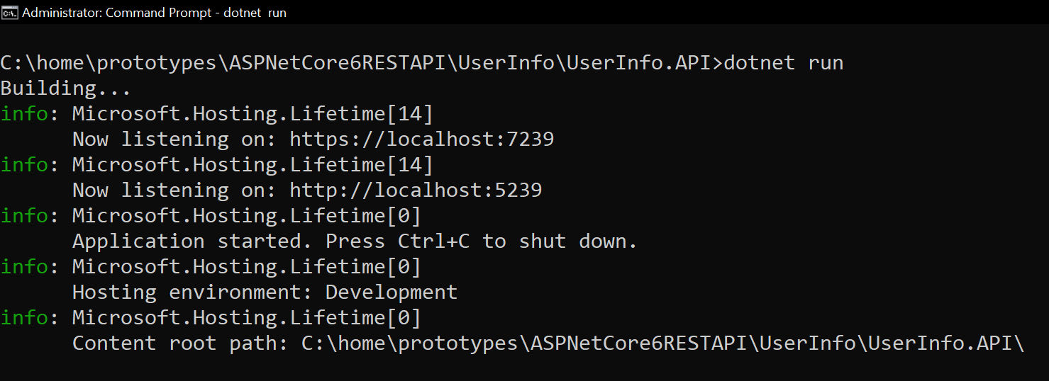
Dotnet run
Ctrl + c to shutdown the application.

Slide 19
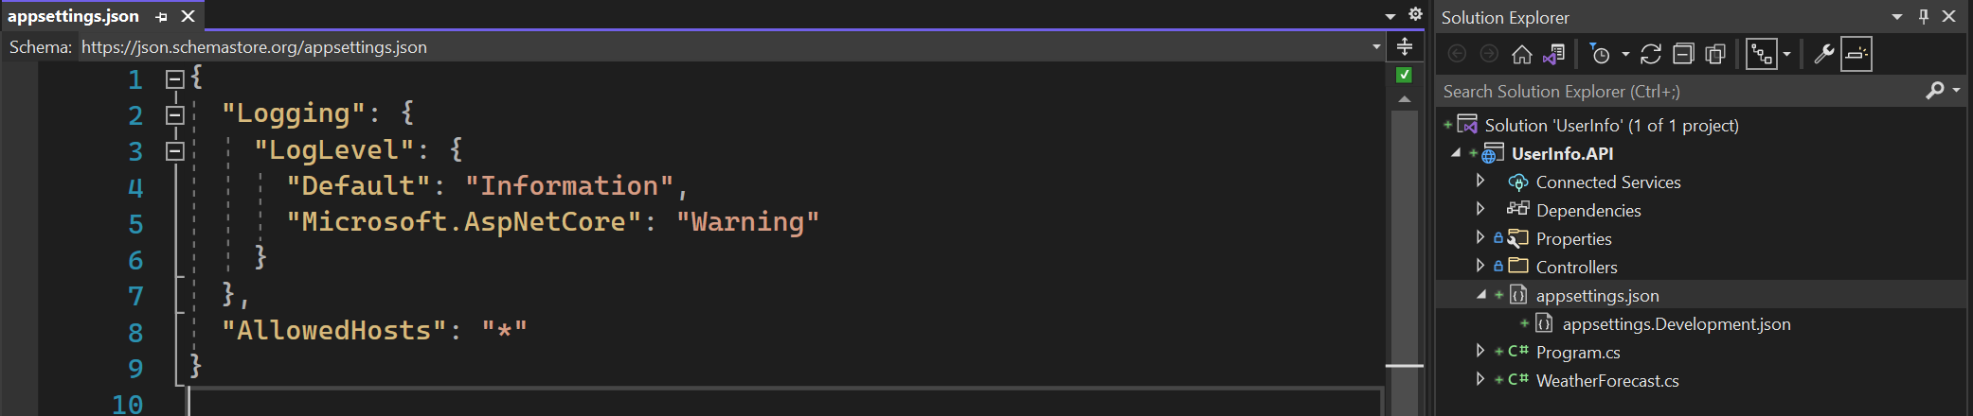
Appsettings.json
Default appsettings.json that allowed host.

Slide 20
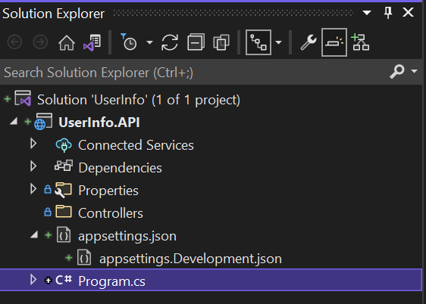
Delete weatherforecastcontroller and weatherforecast

Slide 21
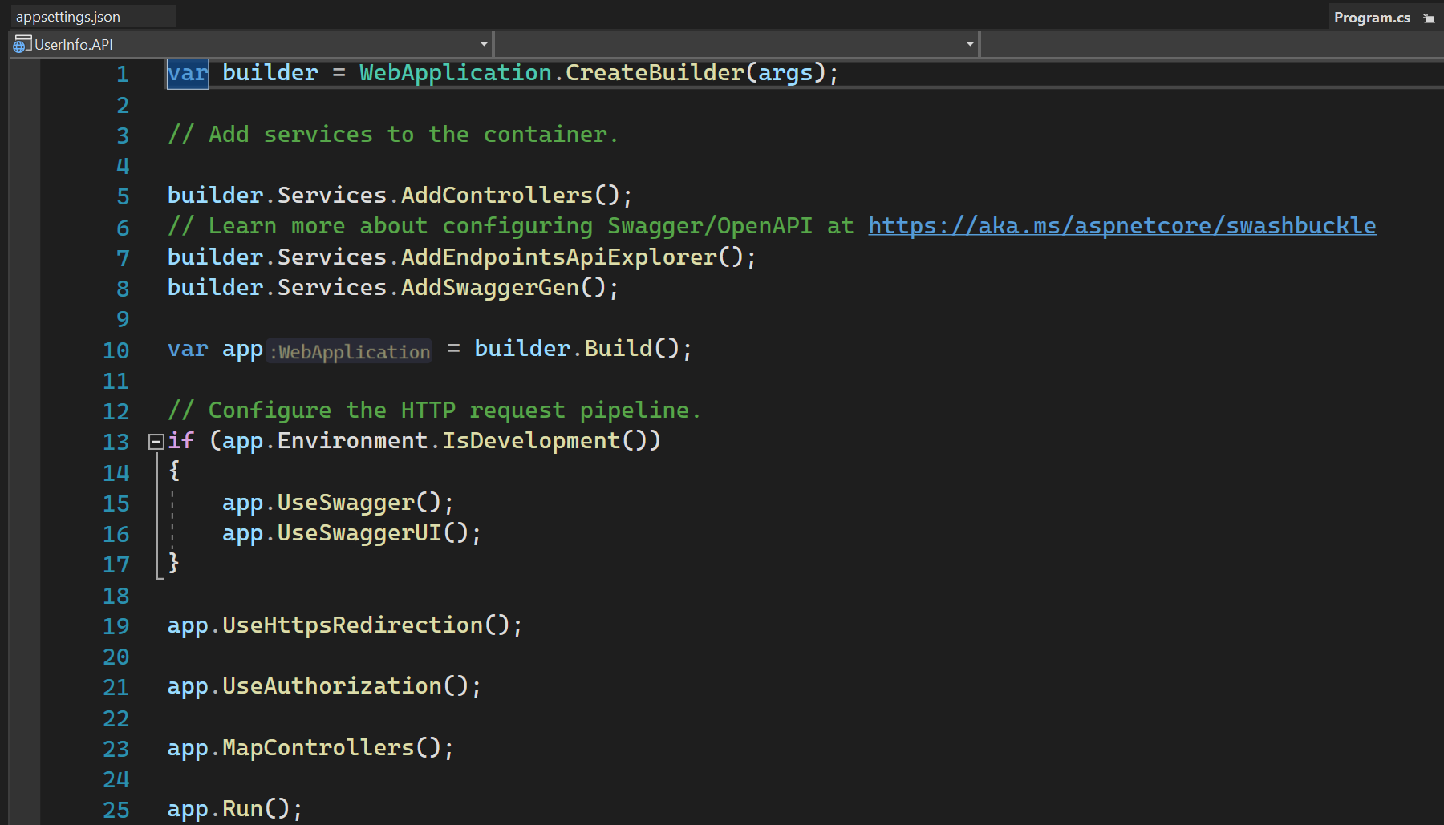
Top level statement feature

Slide 22
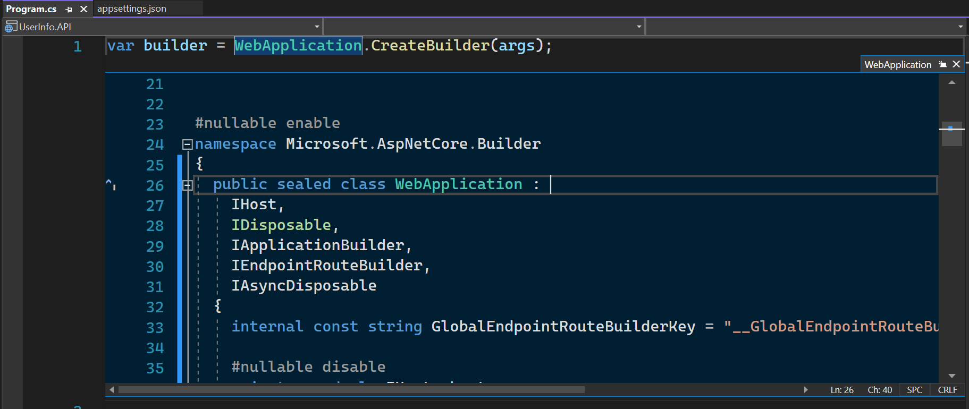
Iapplicationbuilder
IApplicationBuilder : Provides a mechanism to configure application request pipeline and that’s exactly what we do next.
By doing so, how ASP.Net Core will respond to individual HTTP requests. The components that potentially handle these
requests are called as MiddleWare.

Slide 23
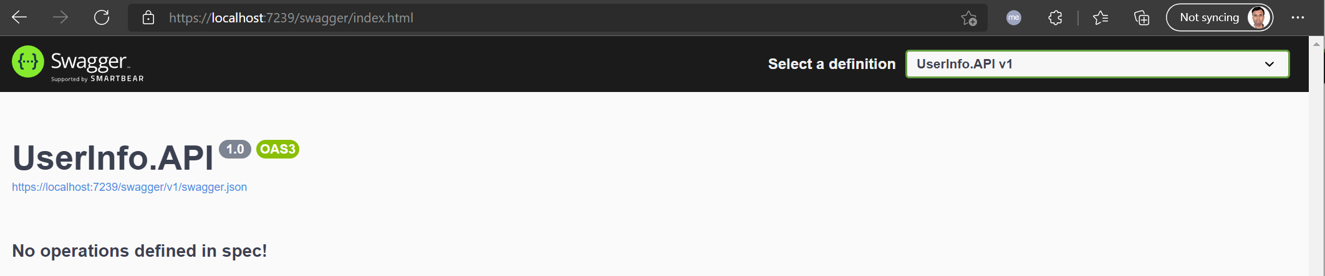
swagger

Slide 24
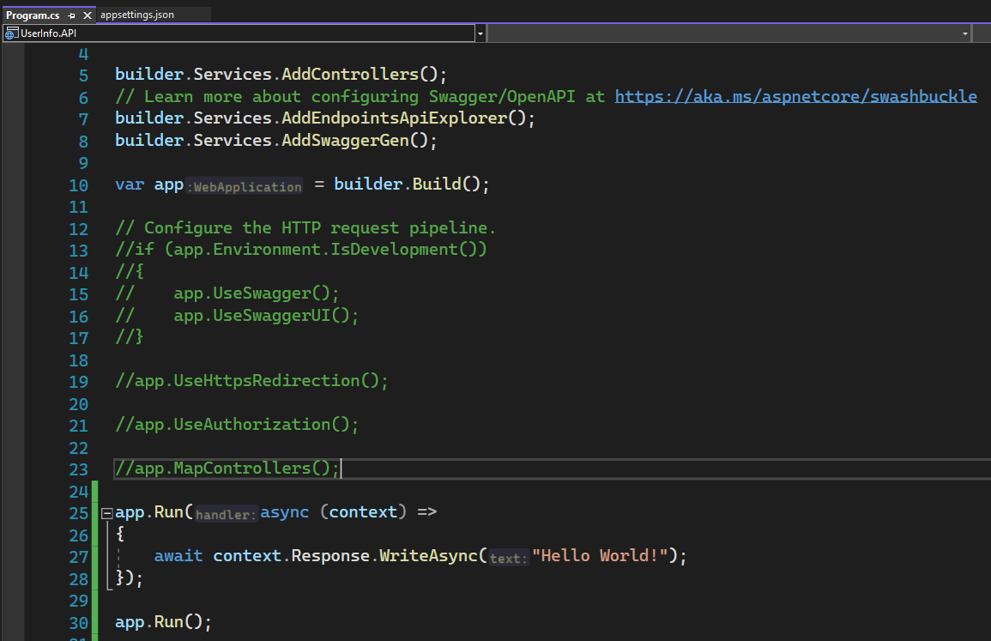
APP.Run

Slide 25
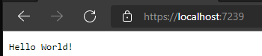
Run the application

Slide 26
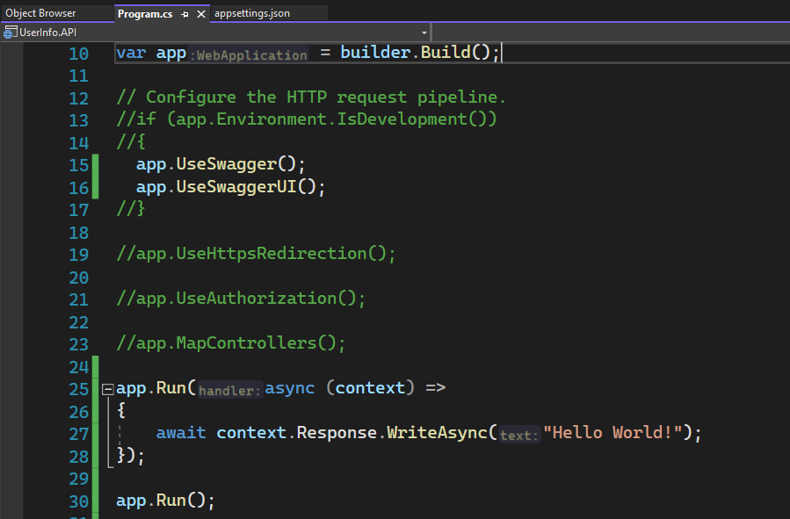
Enable swagger

Slide 27
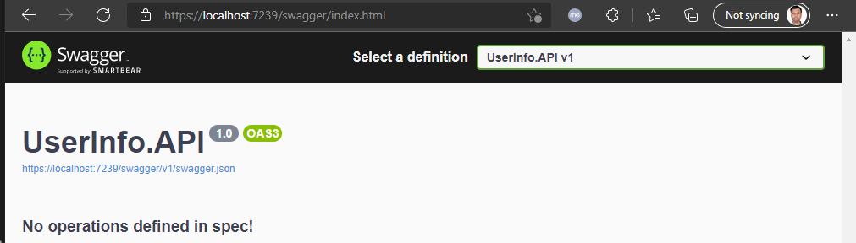
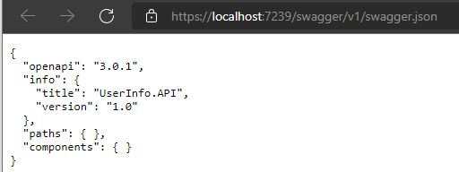
SWAGGER UI
<- This file being interpreted and transformed into UI.

Slide 28
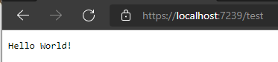
Any other request

Slide 29
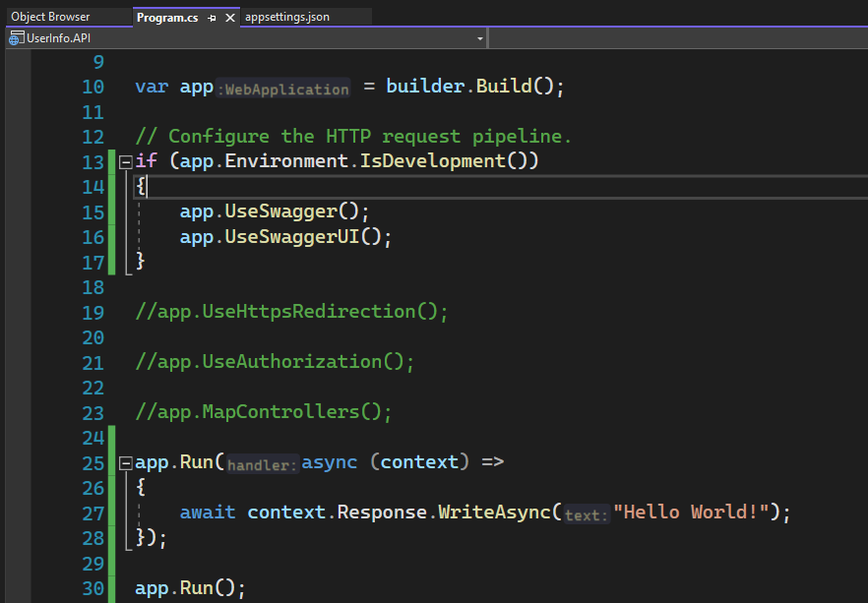
Enable development environment

Slide 30
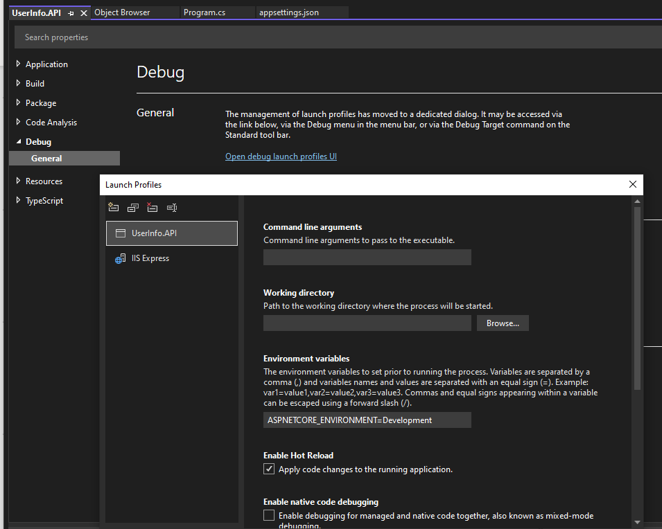
ASPNETCORE_ENVIRONMENT - development

Slide 31
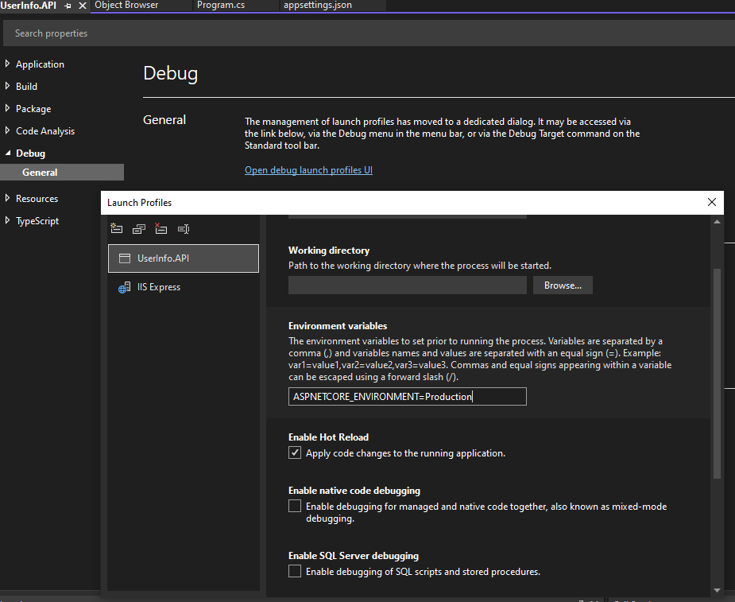
ASPNETCORE_ENVIRONMENT - production

Slide 32
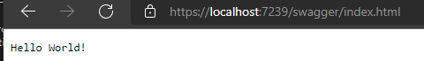
Run the application

Slide 33
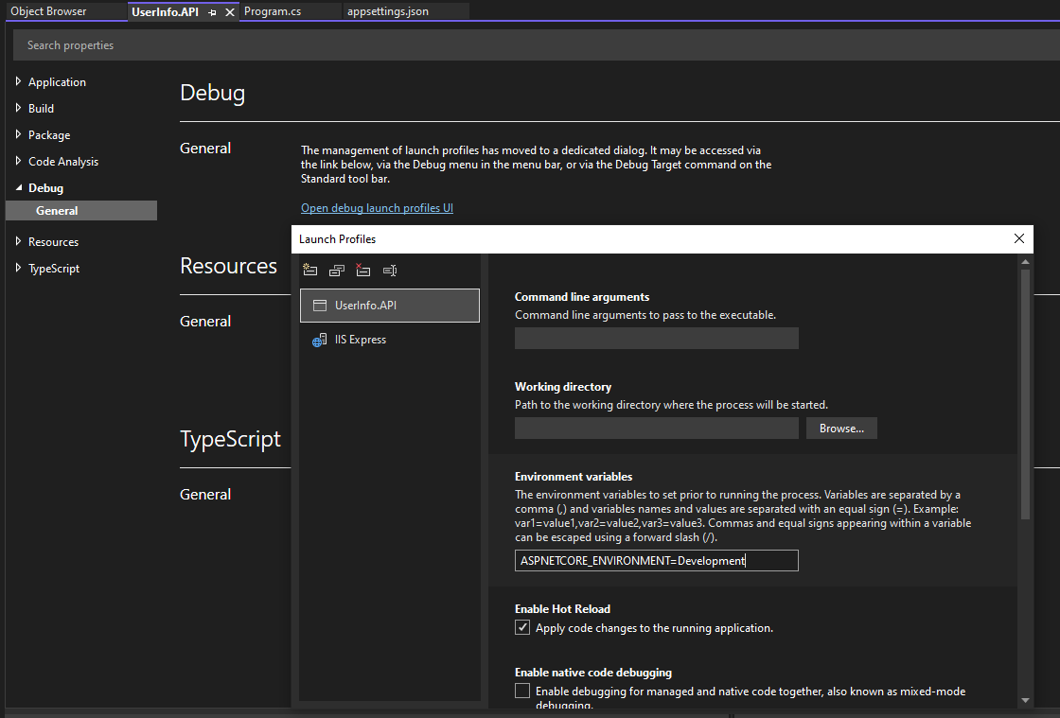
Aspnetcore_environment = development

Slide 34
API and return responses

Slide 35
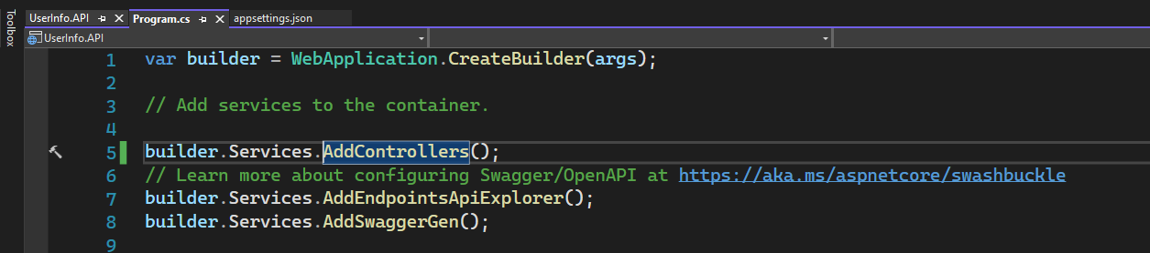
Alternatives to builder.services.addcontrollers
builder.services.AddMvc
builder.services.AddMvcCore
builder.services.AddControllerWithViews - -Support for building HTML Razor views

Slide 36
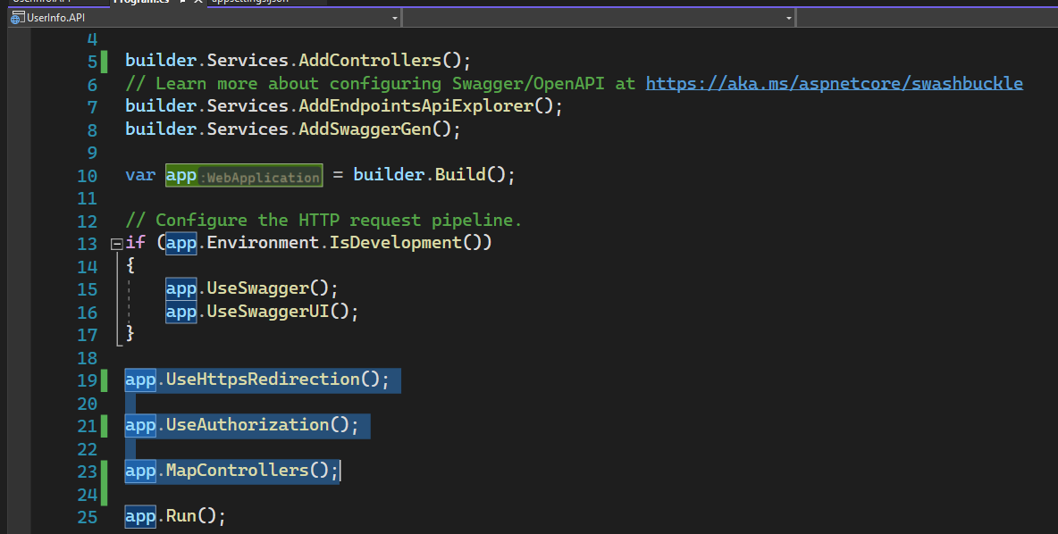
UserInfo.API

Slide 37
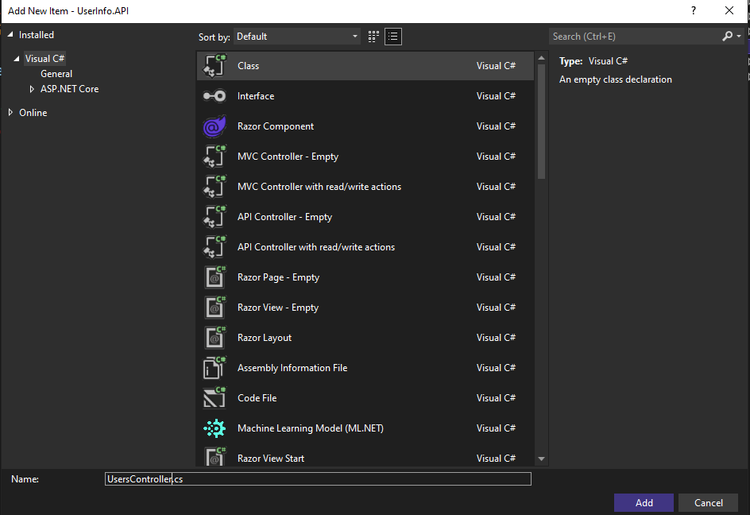
userscontroller

Slide 38
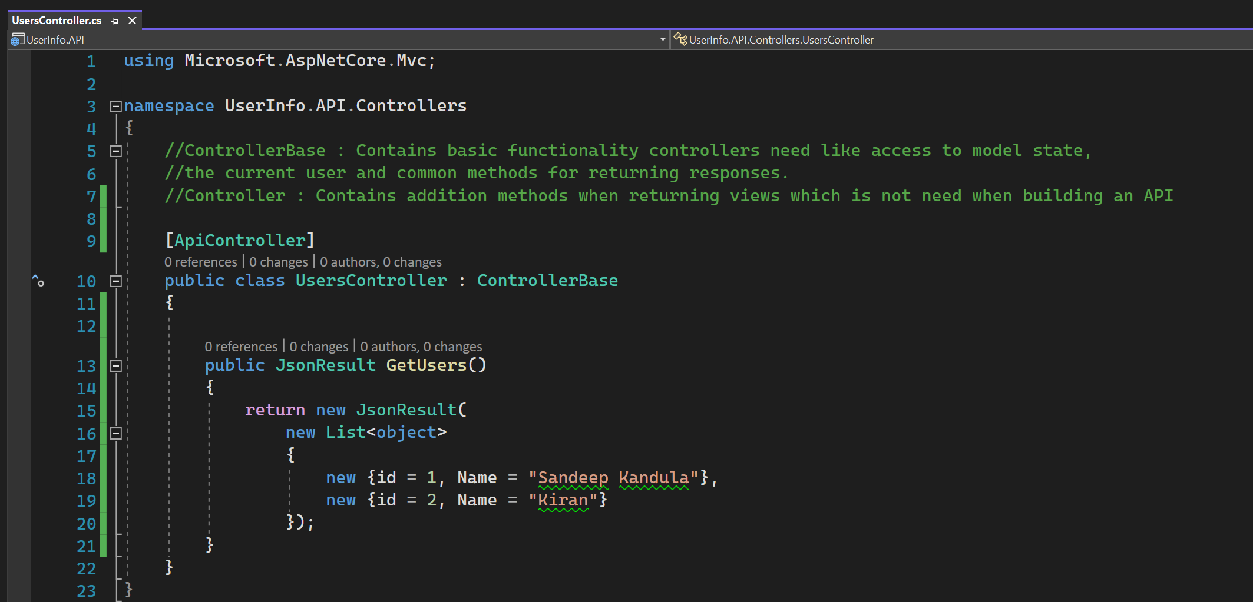
Return JSON RESULT

Slide 39
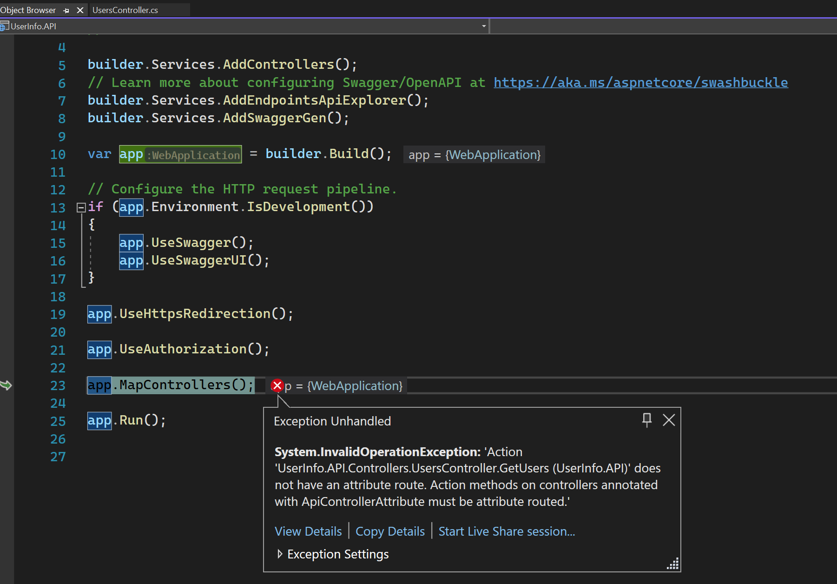
Attribute route

Slide 40
Routing in ASP.Net Core
https://docs.microsoft.com/en-us/aspnet/core/fundamentals/routing?view=aspnetcore-6.0
App.UseRouting()
Marks the position in the middleware pipeline where a routing decision is made.
App.UseEndpoints()
Marks the position in the middleware pipeline where the selected endpoint is executed.

Slide 41
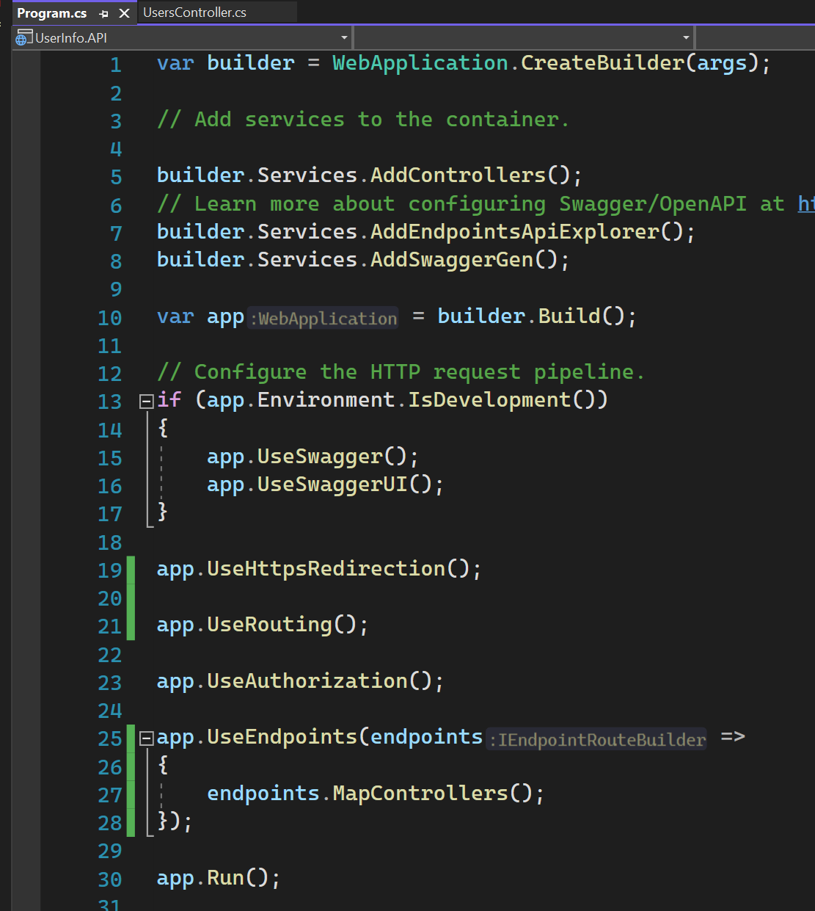
Add UseRouting and USEENDPOINTS

Slide 42
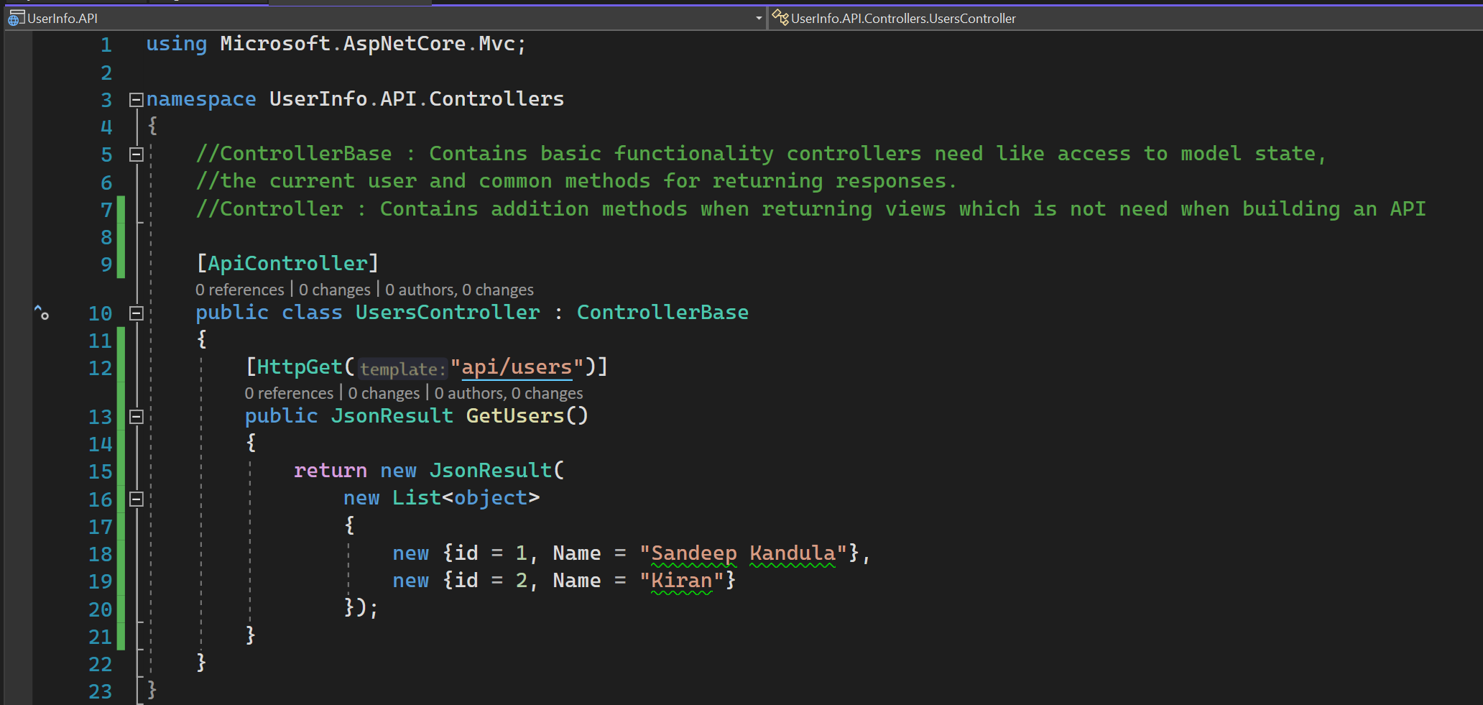
Api/users

Slide 43
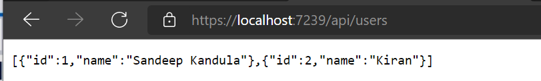
test

Slide 44
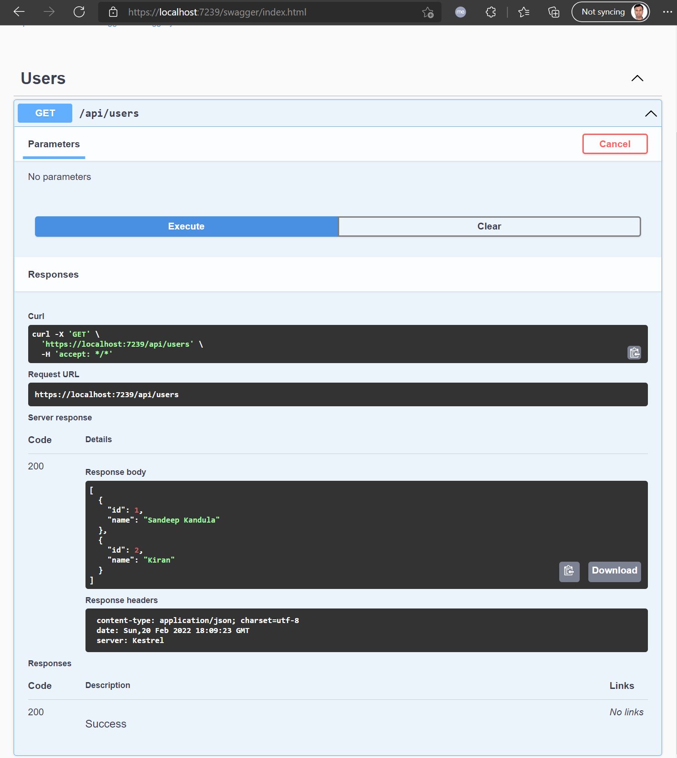
test

Slide 45
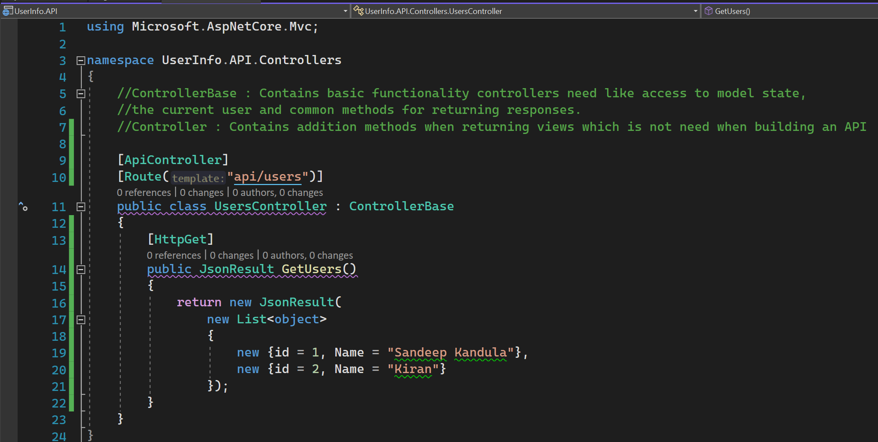
Add route

Slide 46
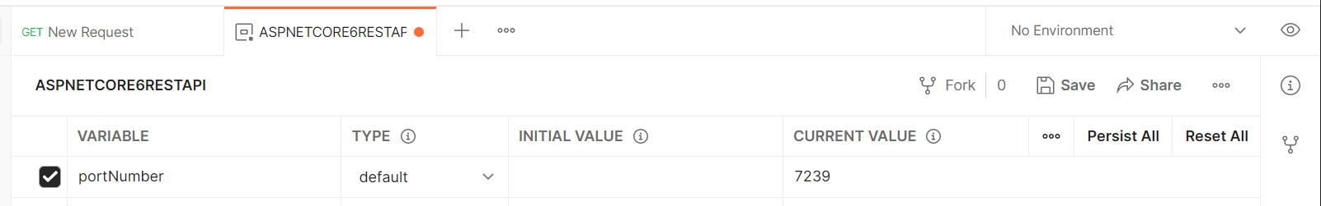
Add environment variable

Slide 47
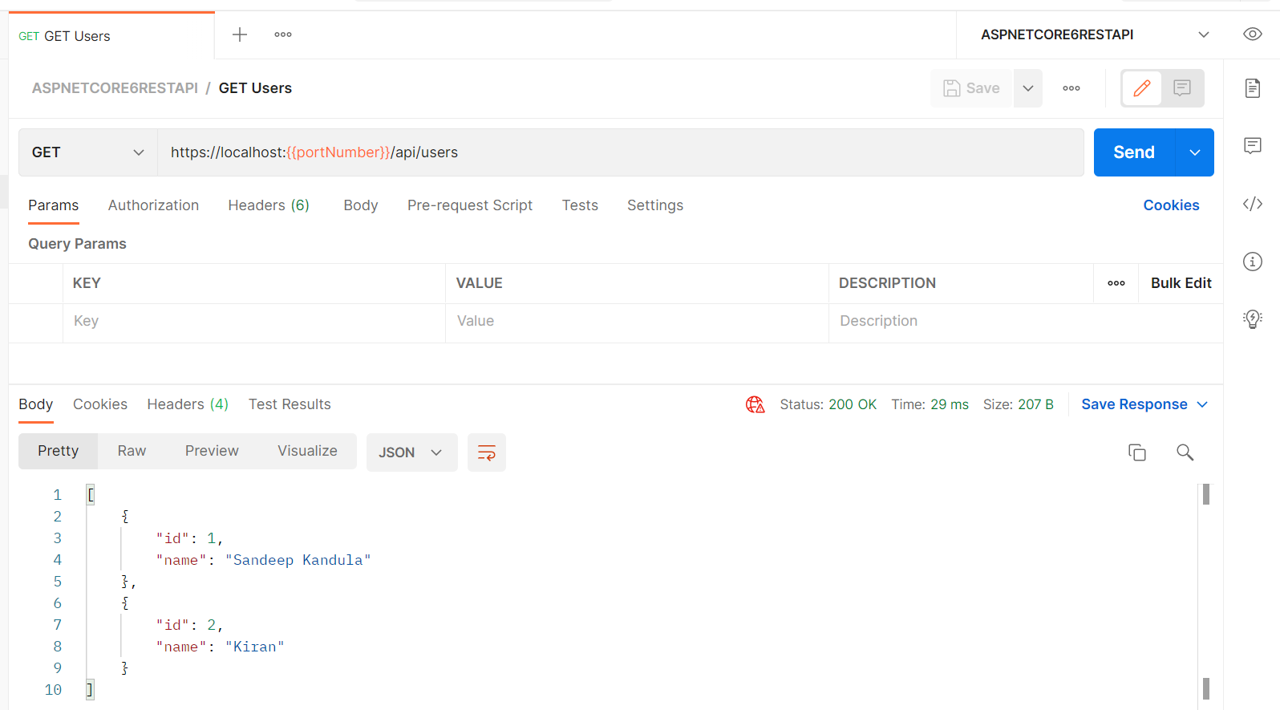
Get users

Slide 48
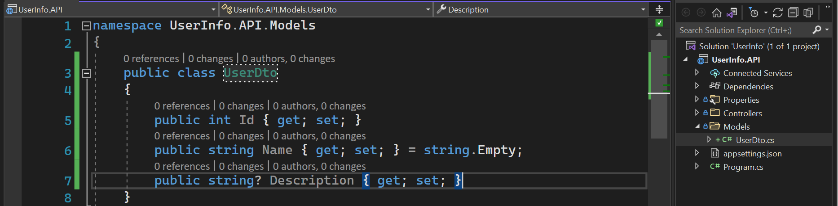
Improve model classes

Slide 49
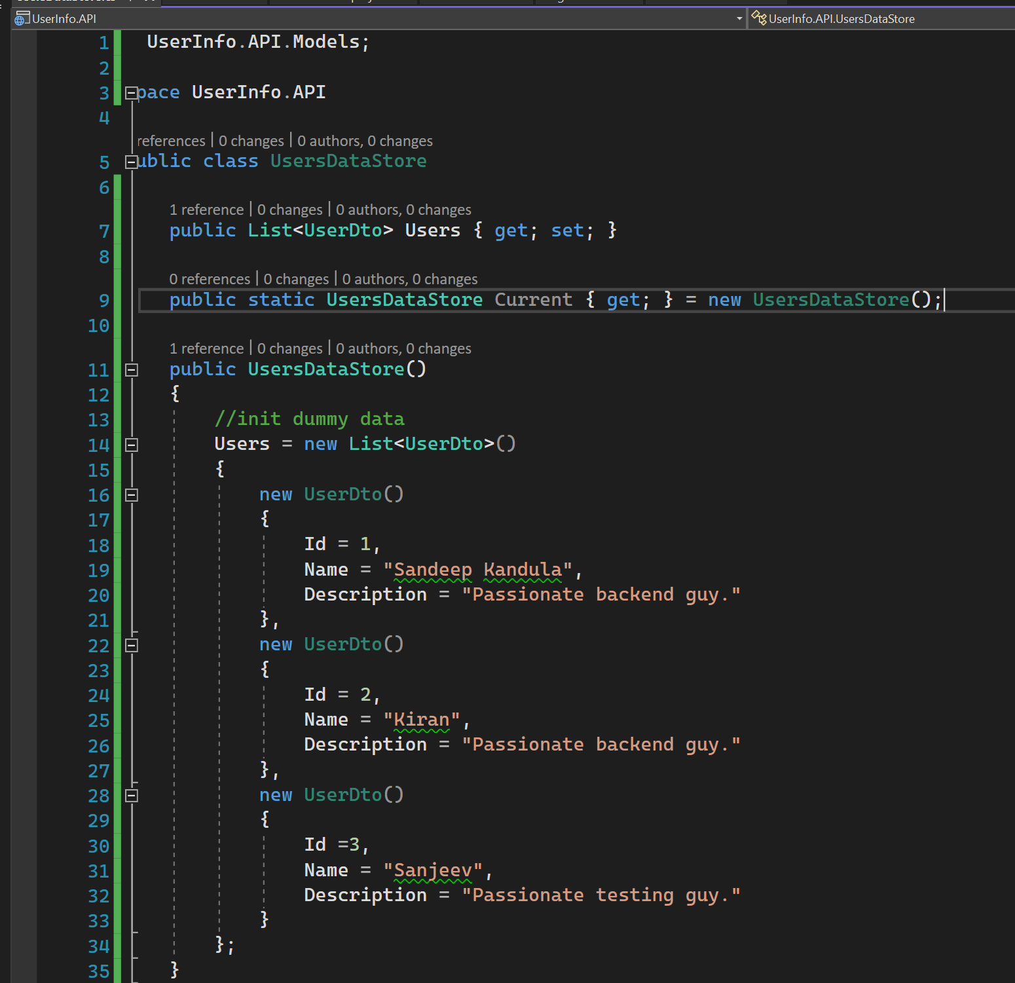
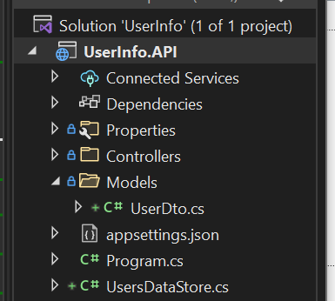
UsersDataStore

Slide 50
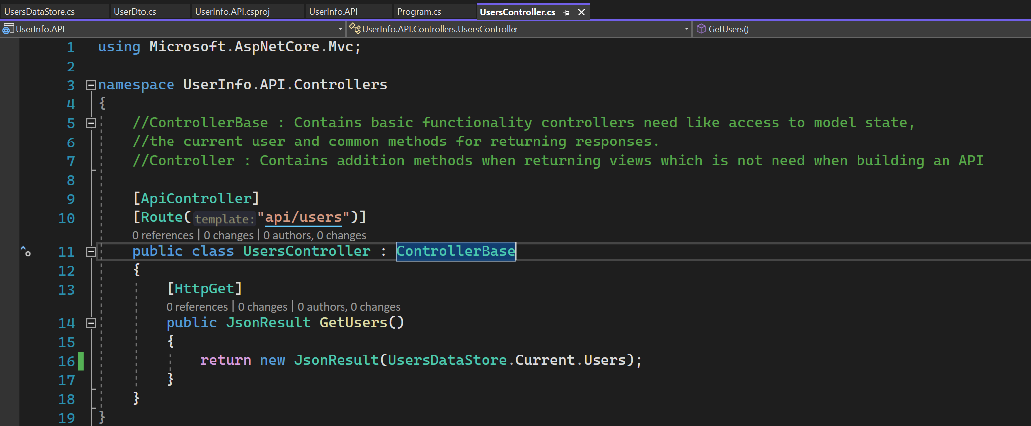
Change the controller

Slide 51
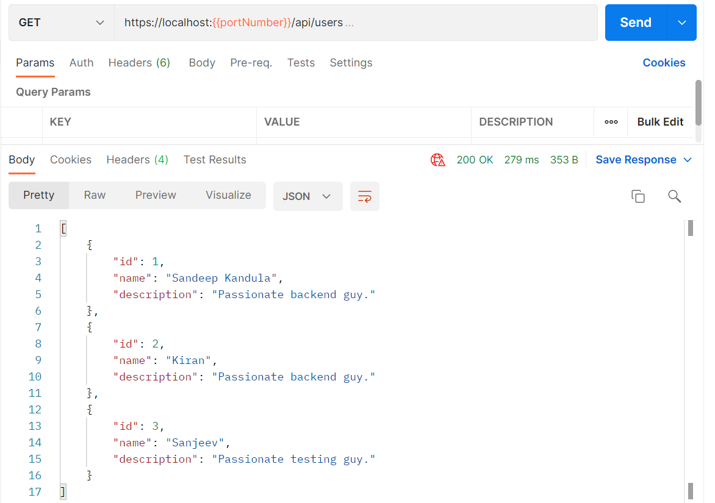
TEST API

Slide 52

Get user by id

Slide 53

Get USER BY ID

Slide 54

NOT FOUND

Slide 55

null

Slide 56

Way of returning status codes

Slide 57

Use actionresult

Slide 58

NOT FOUND

Slide 59

FOUND

Slide 60

Point of interest dto

Slide 61

User DTO with Child

Slide 62

Fill the data

Slide 63

Points of interest controller

Slide 64

POINTSOFINTEREST CONTROLLER
Not IEnumerable.
Should return PointOfInterestDto

Slide 65

Swagger

Slide 66

Return child resource

Slide 67

NOT FOUND

Slide 68

POINT OF INTEREST

Slide 69

NOT FOUND

Slide 70

NOT FOUND

Slide 71

Get user

Slide 72
Format response data
https://docs.microsoft.com/en-us/aspnet/core/web-api/advanced/formatting?view=aspnetcore-6.0
Output Formatter :
Deals with output
Media Type : Accept header
Input Formatter:
Deals with input
Media type : Content-Type header

Slide 73

Accept HEADER

Slide 74

ACCEPT HEADER WITH XML RETURNS JSON

Slide 75


RETURN HTTP NOT ACCEPTABLE

Slide 76


Support xml

Slide 77

Default json

Slide 78

Files controller

Slide 79

File
FileContentResult
FileStreamResult
PhysicalFileResult
VirtualFileResult
File

Slide 80

Download file

Slide 81

File does not support file format

Slide 82

Add FileextensionContentTypeProvider

Slide 83

GET FILE

Slide 84

Observe content type got changed
File download will happen and can view the file.

Slide 85
Passing data to the api
Binding source attribute tells the model binding engine where to find the binding source.
Binding Source Attribute |  | Remarks
[FromBody] | Request body | Inferred for complex types
[FromForm] | Form data in the request body | Inferred for action parameters for type IFormFile and IFormFileCollection
[FromHeader] | Request header
[FromQuery] | Query string parameters | Inferred for any other action parameter.
[FromRoute] | Route data from the current request | Inferred for an action parameter name matching a parameter in the route template
[FromService] | Service injected as an action parameter
By default, ASP. Net core attempts to use the complex object binder.
APIController attribute changes the rules to better fit API’s.

Slide 86


HTTP POST : Point of interest

Slide 87

HTTP POST

Slide 88

Created at route

Slide 89

Empty body
//APIController attribute had generated this validation error

Slide 90

Invalid property

Slide 91

Data annotations

Slide 92

Option to provide as apicontroller checks the model state

Slide 93

Model validation

Slide 94

Error messages

Slide 95

With error messages from the code

Slide 96
Need to consider fluent validation
Data Annotations are OK for simple use cases.
https://fluentvalidation.net/

Slide 97

Update DTO

Slide 98

HTTP PUT

Slide 99

POSTMAN - 1

Slide 100

POSTMAN - 2

Slide 101

Postman 3

Slide 102

Postman 4

Slide 103

Partially update a resource
https://datatracker.ietf.org/doc/html/rfc6902
https://www.nuget.org/packages/Microsoft.AspNetCore.JsonPatch/

Slide 104

Install two packages

Slide 105

Replace

Slide 106

Still works

Slide 107

patch

Slide 108

PATCH BODY

Slide 109

POSTMAN GET to verify patch

Slide 110

PATCH (update multiple)

Slide 111

Check get

Slide 112

INVALID REQUEST

Slide 113

PATCH update (multiple)

Slide 114

PATCH - Mandatory fields removed - 1
Use remove instead of replace.

Slide 115

PATCH - Mandatory fields removed - 2

Slide 116

PATCH - Mandatory fields removed - 3

Slide 117

PATCH - Mandatory fields removed - 4
Use remove instead of replace.

Slide 118

HTTP DELETE

Slide 119

HTTP DELETE – POINT OF INTEREST

Slide 120

GET POINT OF INTEREST

Slide 121
Working with services and dependency injection

Slide 122

CREATEBUILDER – Defaults 1

Slide 123

Create builder – defaults 2

Slide 124

Create builder – defaults - 3

Slide 125

Add LOGGER

Slide 126

Observe log

Slide 127

Change the default to warning

Slide 128

Add namespace (UserInfo.api.controllers) - 1

Slide 129

Add namespace (UserInfo.api.controllers) - 2

Slide 130

Handle 500 errors

Slide 131

Handling your request

Slide 132

Critical

Slide 133

Serilog (Install NUGET PACKAGES)

Slide 134

Use serilog

Slide 135

RUN THE API

Slide 136

FATAL ERROR

Slide 137


Logs folder

Slide 138

Service

Slide 139


Dependency injection

Slide 140

Use the service

Slide 141

TEST THE SERVICE

Slide 142

IMailService

Slide 143

Cloud MAIL SERVICE

Slide 144


Use interface

Slide 145


Debug /RELEASE

Slide 146

Test the service

Slide 147

User data store - 1

Slide 148


User data store - 2

Slide 149

Configuration files

Slide 150

Create DEFAULT builder – add json

Slide 151

Take configurations - 1

Slide 152

Take configurations - 2

Slide 153

TEST CONFIGURATIONs

Slide 154

AppSETTINGS FILE

Slide 155


APPSETTINGS

Slide 156

debug

Slide 157

Change environment to production

Slide 158

Test configuration

Slide 159

Change it back to development

Slide 160
EFCORE

Slide 161

user

Slide 162

Point of interest

Slide 163


Add nuget package

Slide 164

Add DBCOntext

Slide 165


dbcontext

Slide 166

Add database

Slide 167

Dbcontext options overloads

Slide 168

UserInfoCOntext options

Slide 169
dbcontextoptions

Slide 170


Add nuget package

Slide 171

Update database

Slide 172

PGADMIN

Slide 173

Add description

Slide 174

Add migration

Slide 175

Data seed - 1

Slide 176

Data seed - 2

Slide 177

ADD MIGRATION

Slide 178


UpdateDatabase

Slide 179


Storing sensitive data – DEVLOPMENT

Slide 180

Storing sensitive data – production - 1

Slide 181

Storing sensitive data – production - 2

